Slide 1
Network DEA in Insurance Industry
吳延東

Slide 2
Network DEA model(according to Kao 2008)
Revised network DEA model

Slide 3
Network DEA model(according to Kao 2008)
Revised network DEA model

Slide 4
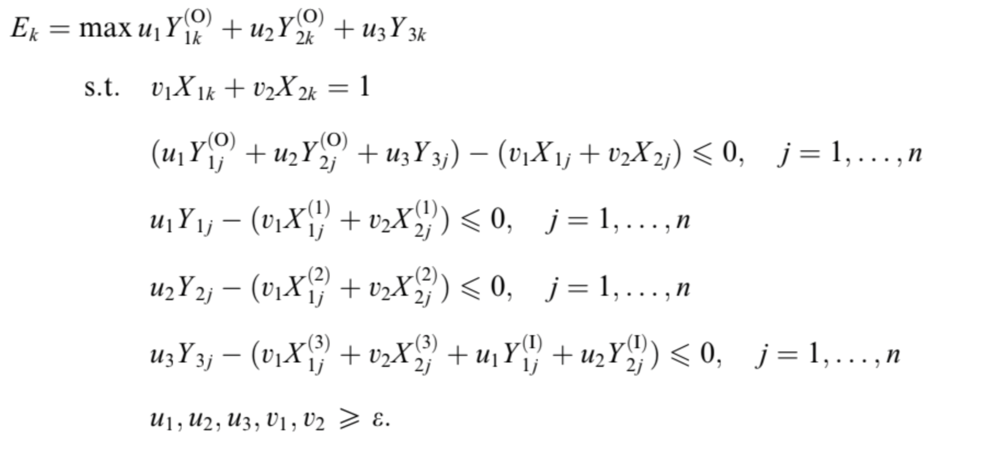
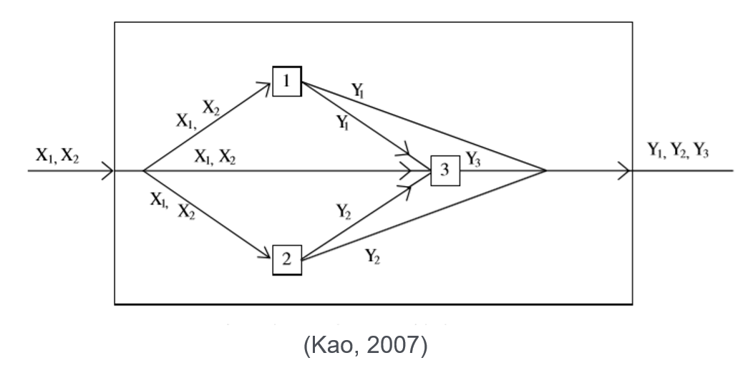
Network DEA model(according to Kao 2008)
Network DEA in Insurance Industry

Slide 5
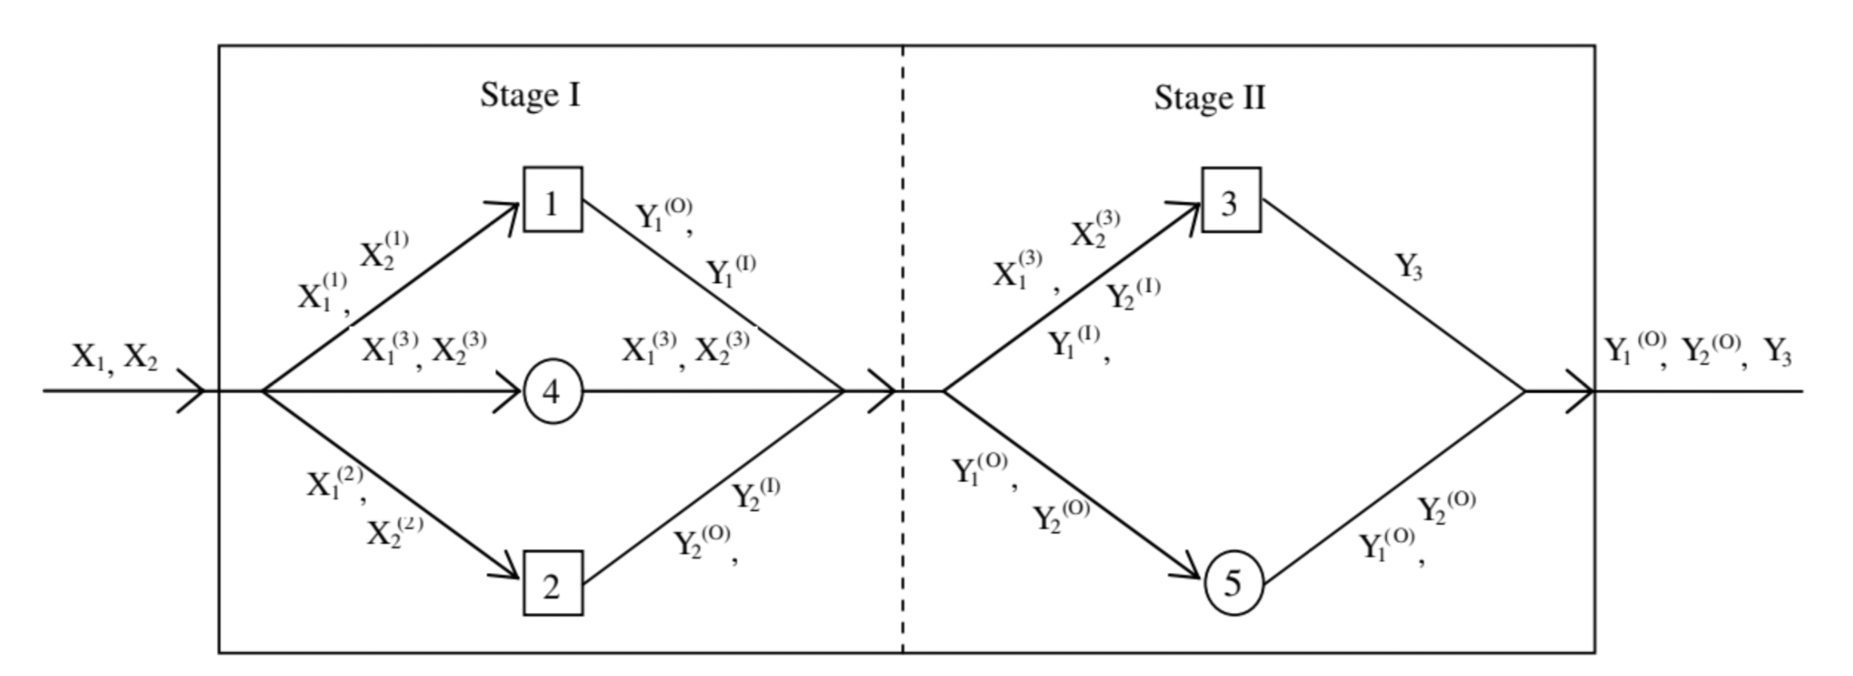
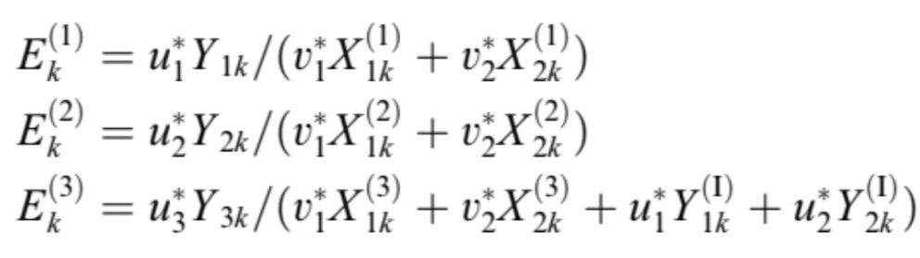
Network DEA model(according to Kao 2008)
Network DEA in Insurance Industry

Slide 6
Network DEA model(according to Kao 2008)
Revised network DEA model

Slide 7
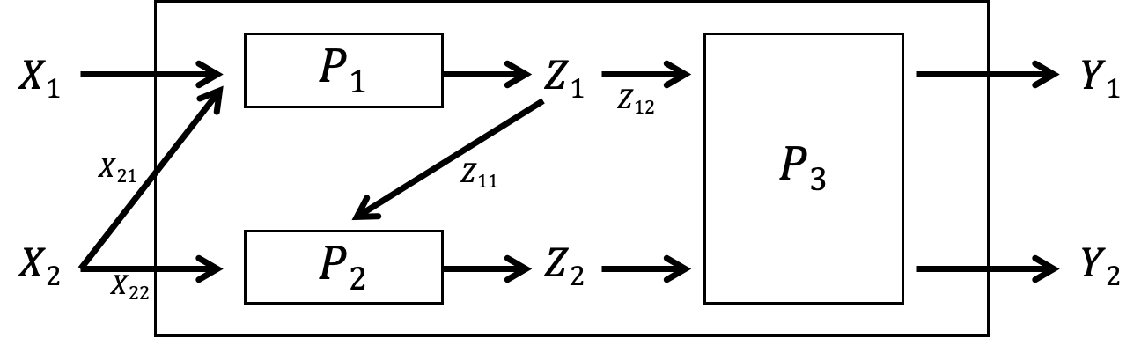



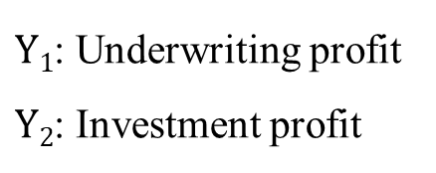



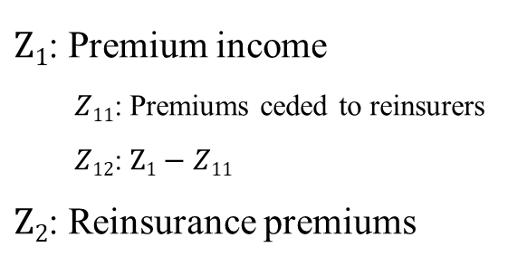



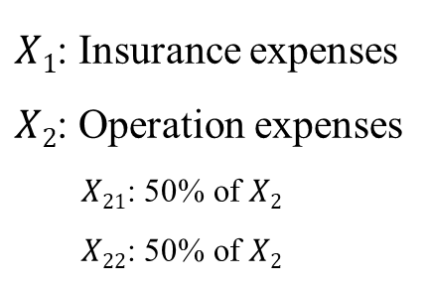


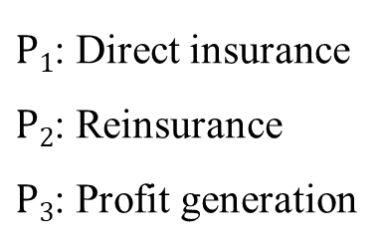


Revised network DEA model
Network DEA in Insurance Industry
Notations:
$X1$: Insurance expenses
$X2$: Operation expenses
$X21$: 50% of $X2$
$X22$: 50% of $X2$
$Z1$: Premium income
$Z11$: Premiums ceded to reinsurers
$Z12$: $Z1−Z11$
$Z2$: Reinsurance premiums
$P1$: Direct insurance
$P2$: Reinsurance
$P3$: Profit generation
$Y1$: Underwriting profit
$Y2$: Investment profit
$$X1$$
$$P1$$
$$Z1$$
$$Y1$$
$$Z12$$
$$X21$$
$$P3$$
$$Z11$$
$$X2$$
$$P2$$
$$Z2$$
$$Y2$$
$$X22$$

Slide 8
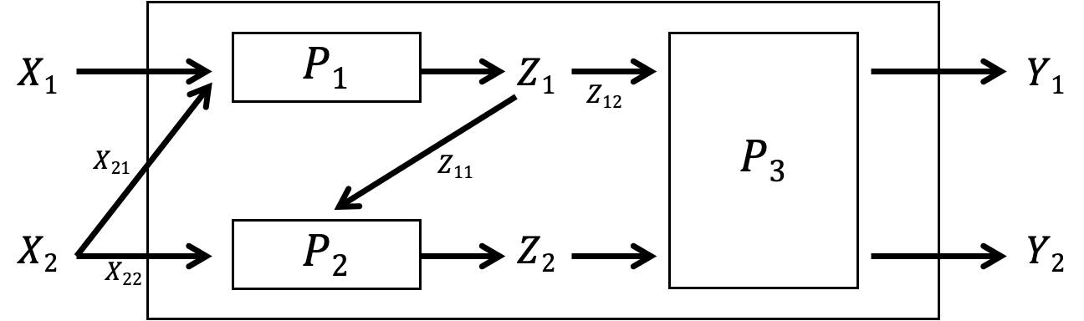
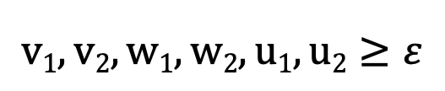
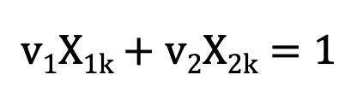
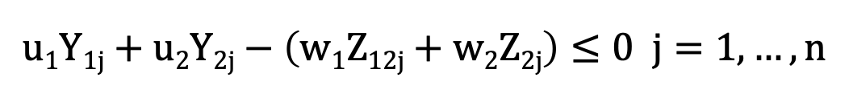
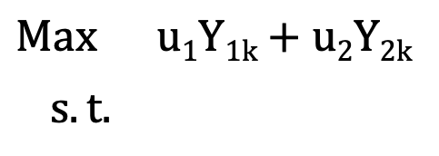
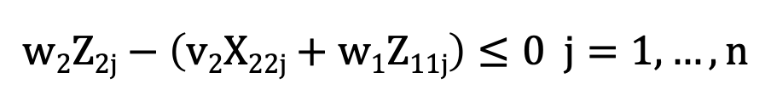
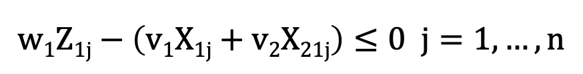
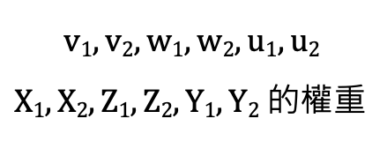
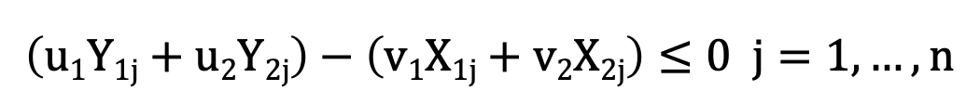
Revised network DEA model
Network DEA in Insurance Industry
$$v1, v2, w1, w2, u1, u2$$
$X1, X2, Z1, Z2, Y1, Y2$ 的權重
$$Max u1Y1k+u2Y2k$$
$s.t.$
$$v1X1k+v2X2k=1$$
$$\left(u1Y1j+u2Y2j\right)−\left(v1X1j+v2X2j\right)≤0 j=1,…,n$$
$$w1Z1j−\left(v1X1j+v2X21j\right)≤0 j=1,…,n$$
$$w2Z2j−\left(v2X22j+w1Z11j\right)≤0 j=1,…,n$$
$$u1Y1j+u2Y2j−\left(w1Z12j+w2Z2j\right)≤0 j=1,…,n$$
$$v1, v2, w1, w2, u1, u2≥ε$$

Slide 9
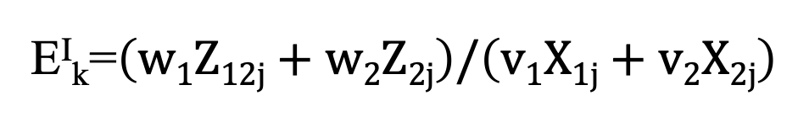
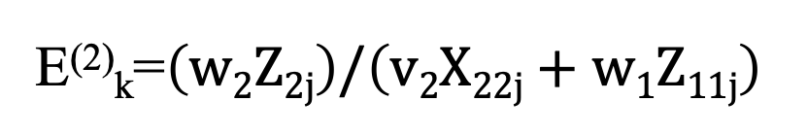
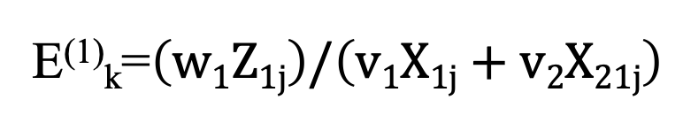
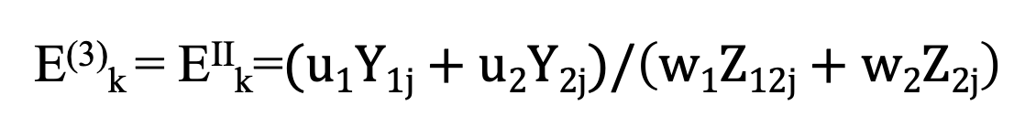
Revised network DEA model
Network DEA in Insurance Industry
E⁽¹⁾_{k}=$\left(w1Z1j\right)/\left(v1X1j+v2X21j\right)$
E⁽²⁾_{k}=$\left(w2Z2j\right)/\left(v2X22j+w1Z11j\right)$
E^{I}_{k}=$\left(w1Z12j+w2Z2j\right)/\left(v1X1j+v2X2j\right)$
E⁽³⁾_{k} = E^{II}_{k}=$(u1Y1j+u2Y2j)/\left(w1Z12j+w2Z2j\right)$

Slide 10
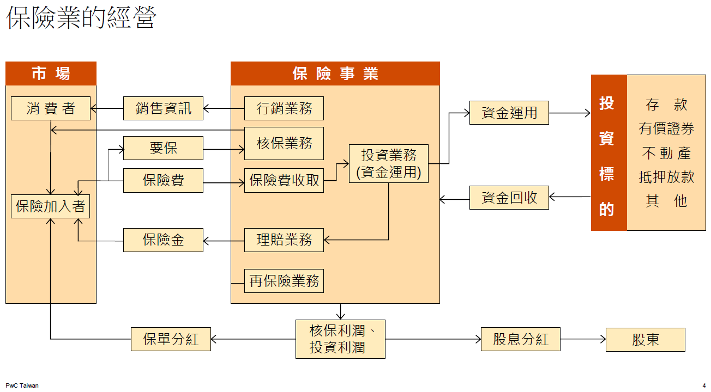
Network DEA in Insurance Industry
保險業務會影響再保分保業務
理賠與投資同時進行

